Slide 1

CREATIVE THINKING FINAL PRESENTATION
By:- Ali Latif

Slide 2
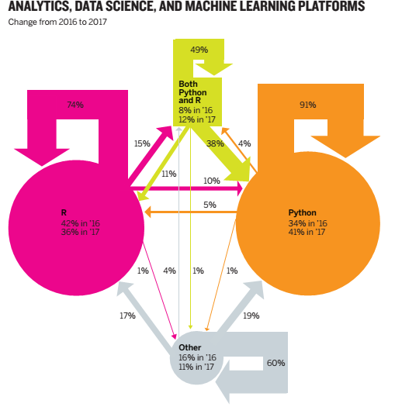
PRESENTED DATA

Slide 3
REQUIREMENTS
Critique the chart in slide 1. Understanding that it shows the proportion of people using each platform and the proportion of those who switched from one to the other, explain why you think it’s not as effective as it could be. Provide at least three examples.
Sketch at least three alternative approaches to charting this data. Choose whatever context you want to highlight.
Make slides accordingly to present it to an audience approximately 50 people with diverse background (30 – 45 years professionals)
Time of presentation is 8 – 10 minutes

Slide 4


Review
The given chart scrambles up a lot of information regarding the usage of different technology platforms for two years making it very hard to extract the required information.
The chart shows up percentage change, percentage retained and percentage switch in the same picture making it difficult to analyze, compare and retain information.
The relationship and trends between the percentage changes of the users is not clear.
Some of the data is erroneous for example total percentage of switch in case of python sums up to 101% while switch in case of both sums up to 99%.

Slide 5
YEARLY COMPARISON: Percentage users
2016
2017
34%
42%
8%
16%
41%
36%
12%
11%
Python
R
Both
Other
Python
R
Both
Other

Slide 6
PERCENTAGE SWITCHING : From 2016 to 2017

Slide 7
PERCENTAGE RETAIN AND CHANGE : From 2016 to 2017

Slide 8

TRENDS FROM 2016 TO 2017
Python
R
Both
Others
Python has retained more than 91% of its users.
Python has seen 20.5 % increase in its users.
Users of both python and R as well as other languages have switched to python.
R has retained almost 3/4th of its users.
R has seen a decrease of 14.3% in its users.
Users of other languages and a small amount of python users have switched to R.
Both R and python have retained almost half of their users.
Both languages cumulatively have seen a 50% increase in their users.
15% users of R have switched to both languages.
Others have retained 60% of their users.
Others have seen a sharp decrease of 31% in their users.
Small amount of python and R users have switched to others.

Slide 9
Conclusion
Single chart should represent single piece of information or at most two types of data that is interrelated.
Jumbling up multiple sorts of data in a single chart makes it difficult to understand, analyze and retain.
The three graphs produced now have made the trends clear and the information easy to understand.

Slide 10


THANK YOU!
Ali Latif
ali.latif@curemd.com

